Slide 1
Retrieving Data Using the SQL SELECT Statement

Slide 2
Objective
After completing this lesson, you should be able to do the following:
List the capabilities of SQL SELECT statements
Execute a basic SELECT statement

Slide 3
Agenda
Capabilities of SQL SELECT Statements
Arithmetic expressions and NULL values in the SELECT statement
Column aliases
Use of concatenation operator, literal character strings, alternative quote operator, and the DISTINCT keyword
DESCRIBE command

Slide 4
Capabilities of SQL SELECT Statements
Projection
Selection
Table 1
Table 1
Join
Table 1
Table 2

Slide 5
Basic SELECT Statement
SELECT {*|[DISTINCT] column|expression [alias],...}
FROM table;
SELECT specifies the columns to be displayed.
FROM specifies the table containing those columns.

Slide 6
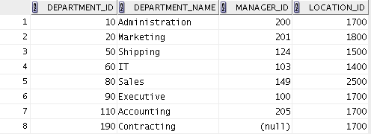
Selecting All Columns
SELECT *
FROM departments;

Slide 7
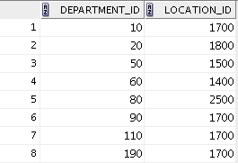
Selecting Specific Columns
SELECT department_id, location_id
FROM departments;
Notes:
…

Slide 8
Writing SQL Statements
SQL statements are not case sensitive.
SQL statements can be entered on one or more lines.
Keywords cannot be abbreviated or split across lines.
Clauses are usually placed on separate lines.
Indents are used to enhance readability.
In SQL Developer, SQL statements can be optionally terminated by a semicolon (;). Semicolons are required when you execute multiple SQL statements.
In SQL*Plus, you are required to end each SQL statement with a semicolon (;).

Slide 9
Column Heading Defaults
SQL Developer:
Default heading alignment: Left-aligned
Default heading display: Uppercase
SQL*Plus:
Character and Date column headings are left-aligned.
Number column headings are right-aligned.
Default heading display: Uppercase

Slide 10
Agenda
Capabilities of SQL SELECT Statements
Arithmetic expressions and NULL values in the SELECT statement
Column Aliases
Use of concatenation operator, literal character strings, alternative quote operator, and the DISTINCT keyword
DESCRIBE command

Slide 11
Arithmetic Expressions
Create expressions with number and date data by using arithmetic operators.
Operator
Description
+
Add
-
Subtract
*
Multiply
/
Divide

Slide 12
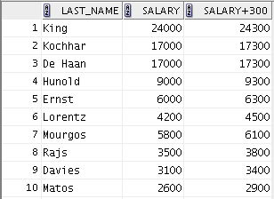
Using Arithmetic Operators
SELECT last_name, salary, salary + 300
FROM employees;
…

Slide 13
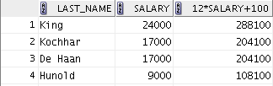
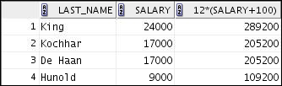
Operator Precedence
SELECT last_name, salary, 12*salary+100
FROM employees;
1
…
SELECT last_name, salary, 12*(salary+100)
FROM employees;
2
…

Slide 14



Defining a Null Value
Null is a value that is unavailable, unassigned, unknown, or inapplicable.
Null is not the same as zero or a blank space.
SELECT last_name, job_id, salary, commission_pct
FROM employees;
…
…

Slide 15



Null Values in Arithmetic Expressions
Arithmetic expressions containing a null value evaluate to null.
SELECT last_name, 12*salary*commission_pct
FROM employees;
…
…

Slide 16
Agenda
Capabilities of SQL SELECT Statements
Arithmetic expressions and NULL values in the SELECT statement
Column aliases
Use of concatenation operator, literal character strings, alternative quote operator, and the DISTINCT keyword
DESCRIBE command

Slide 17
Defining a Column Alias
A column alias:
Renames a column heading
Is useful with calculations
Immediately follows the column name (There can also be the optional AS keyword between the column name and the alias.)
Requires double quotation marks if it contains spaces or special characters, or if it is case-sensitive

Slide 18
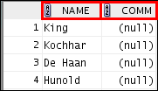
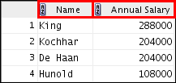
Using Column Aliases
SELECT last_name AS name, commission_pct comm
FROM employees;
…
SELECT last_name "Name" , salary*12 "Annual Salary"
FROM employees;
…

Slide 19
Agenda
Capabilities of SQL SELECT Statements
Arithmetic Expressions and NULL values in SELECT statement
Column Aliases
Use of concatenation operator, literal character strings, alternative quote operator, and the DISTINCT keyword
DESCRIBE command

Slide 20
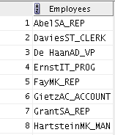
Concatenation Operator
A concatenation operator:
Links columns or character strings to other columns
Is represented by two vertical bars (||)
Creates a resultant column that is a character expression
SELECT last_name||job_id AS "Employees"
FROM employees;
…

Slide 21
Literal Character Strings
A literal is a character, a number, or a date that is included in the SELECT statement.
Date and character literal values must be enclosed within single quotation marks.
Each character string is output once for each row returned.

Slide 22
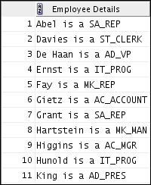
Using Literal Character Strings
SELECT last_name ||' is a '||job_id
AS "Employee Details"
FROM employees;
…
Notes:
…

Slide 23
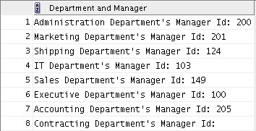
Alternative Quote (q) Operator
Specify your own quotation mark delimiter.
Select any delimiter.
Increase readability and usability.
SELECT department_name || q'[ Department's Manager Id: ]'
|| manager_id
AS "Department and Manager"
FROM departments;

Slide 24
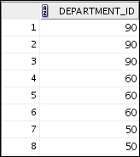
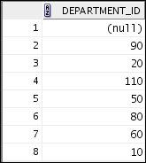
Duplicate Rows
1
2
The default display of queries is all rows, including duplicate rows.
SELECT department_id
FROM employees;
SELECT DISTINCT department_id
FROM employees;
…
Notes:
…

Slide 25
Agenda
Capabilities of SQL SELECT Statements
Arithmetic expressions and NULL values in the SELECT statement
Column aliases
Use of concatenation operator, literal character strings, alternative quote operator, and the DISTINCT keyword
DESCRIBE command

Slide 26
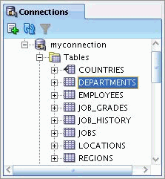
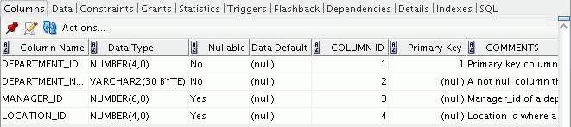
Displaying the Table Structure
Use the DESCRIBE command to display the structure of a table.
Or, select the table in the Connections tree and use the Columns tab to view the table structure.
DESC[RIBE] tablename

Slide 27
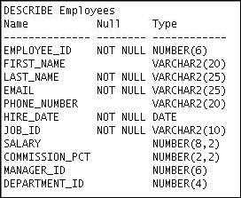
Using the DESCRIBE Command
DESCRIBE employees

Slide 28
Quiz
Identify the two SELECT statements that execute successfully.
SELECT first_name, last_name, job_id, salary*12 AS Yearly Sal FROM employees;
SELECT first_name, last_name, job_id, salary*12 "yearly sal" FROM employees;
SELECT first_name, last_name, job_id, salary AS "yearly sal" FROM employees;
SELECT first_name+last_name AS name, job_Id, salary*12 yearly sal FROM employees;

Slide 29
Summary
In this lesson, you should have learned how to:
Write a SELECT statement that:
Returns all rows and columns from a table
Returns specified columns from a table
Uses column aliases to display more descriptive column headings
SELECT *|{[DISTINCT] column|expression [alias],...}
FROM table;

Slide 30
Practice Overview
This practice covers the following topics:
Selecting all data from different tables
Describing the structure of tables
Performing arithmetic calculations and specifying column names

Slide 31
Initiate an iSQL*Plus session using the user ID and password provided by the instructor.
iSQL*Plus commands access the database. True/False
The following SELECT statement executes successfully: SELECT last_name, job_id, salary AS Sal FROM employees; True/False
The following SELECT statement executes successfully: SELECT * FROM job_grades; True/False
There are four coding errors in this statement. Can you identify them? SELECT employee_id, last_name sal x 12 ANNUAL SALARY
FROM employees;

Slide 32
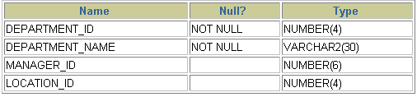
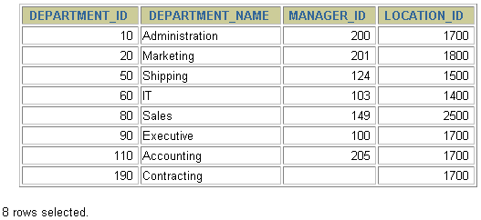
6.Show the structure of the DEPARTMENTS table. Select all data from the table.

Slide 33
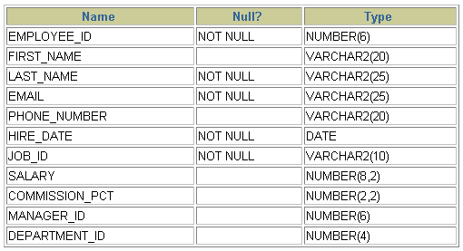
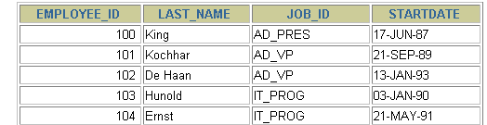
Show the structure of the EMPLOYEES table. Create a query to display the last name, job code, hire date, and employee number for each employee, with employee number appearing first. Provide an alias STARTDATE for the HIRE_DATE column. Save your SQL statement to a file named “prac1.sql”
Run your query in the file “prac1.sql”.

Slide 34
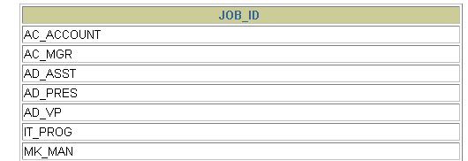
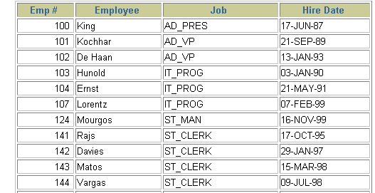
Create a query to display unique job codes from the EMPLOYEES table.
Copy the statement from lab1_7.sql into the iSQL*Plus Edit window. Name the column headings Emp #, Employee, Job, and Hire Date, respectively. Run your query again.

Slide 35
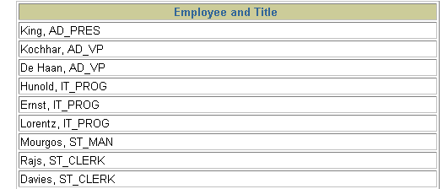
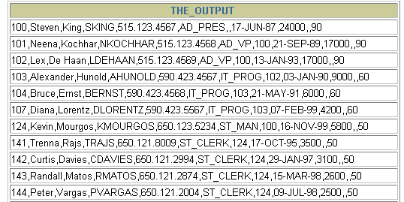
Display the last name concatenated with the job ID, separated by a comma and space, and name the column Employee and Title.
12. Create a query to display all the data from the EMPLOYEES table. Separate each column by a comma. Name the column THE_OUTPUT.

